Slide 1

PRESENTEDBY:- P.LAKSHMI NARAYANA P.SOWJANYA M.DILLSWARI A.RAMYA P.JYOTHIKA MEHER kALYANI

Slide 2
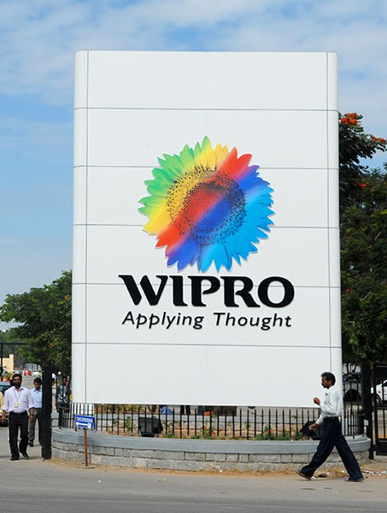
AGENDA
INTRODUCTION
ABOUT DIGITAL MARKETING
WIPRO BRAND STUDY
WIPRO COMPETITOR ANALYSIS
WIPRO CONTENT
WIPRO CURATION

Slide 3


INTRODUCTION
.

Slide 4
INTODUCTION FOR WIPRO IT
Wipro Limited, headquartered in Bangalore, India, is a globally renowned information technology, consulting, and business process services company with a rich history dating back to 1945 when it was founded as Western India Palm Refined Oil Limited.
Over the years, it has transformed into one of India's most prominent and diversified IT firms. Wipro operates in more than 175 cities across 67 countries, serving a diverse client base from various sectors. The company offers a comprehensive range of services, including IT consulting, application development,

Slide 5
INTODUCTION FOR WIPRO IT
infrastructure management, business process outsourcing, and digital transformation solutions.
With a strong focus on emerging technologies like artificial intelligence, cloud computing, and cyber security, Wipro is at the forefront of innovation. Its commitment to corporate social responsibility is exemplified by initiatives that support education, healthcare, and environmental sustainability, including the Azim Premji Foundation.
Wipro's diverse and talented workforce, commitment to innovation, and impressive financial performance make it a significant player in the global IT and consulting industry, reinforcing India's reputation as an IT powerhouse.

Slide 6
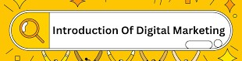
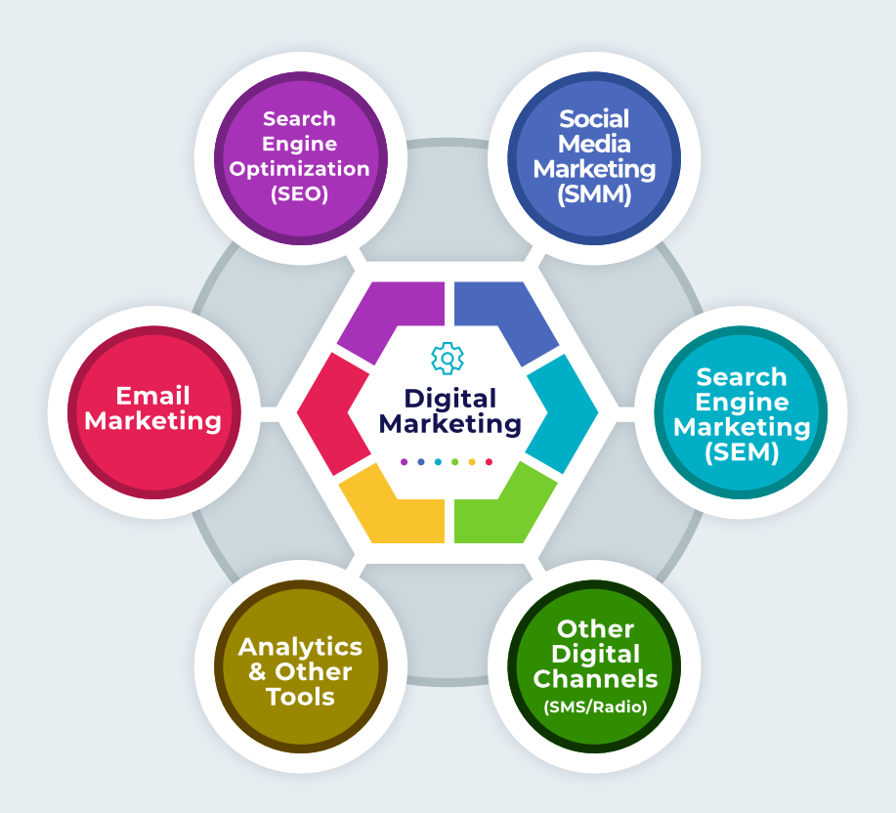
DIGITAL MARKETING INCLUDES :-
ONLINE PRESENCE
SEARCH ENGINE OPTIMIZATION
CONTENT MARKETING
SOCIAL MEDIA MARKETING
EMAIL MARKETING
PAID ADVERTISING
ANALYTICS AND DATA
CONVERSION RATE OPTIMIZATION
MOBILE MARKETING
E-COMMERCE AND ONLINE SALES

Slide 7
BRAND STUDY
A comprehensive brand study of Wipro, a leading global information technology and consulting company, includes an analysis of its branding strategies, core values, mission, vision, corporate culture, and key initiatives. Here's an overview:
*Core Values:* Wipro's core values are integral to its brand identity and strategies. These include integrity, customer-centricity, respect for individuals, innovation, teamwork, and a passion for excellence. These values underpin the company's operations and guide its employees in delivering exceptional service.
*Mission and Vision: *Wipro's mission and vision statements generally revolve around delivering value to clients and leveraging innovation and technology to address global challenges. The company aims to be a trusted partner, promoting sustainable growth and fostering a culture of creativity and continuous improvement.

Slide 8
*Corporate Culture:* Wipro fosters a diverse and inclusive corporate culture. It encourages creativity, learning, and collaboration among its employees. The company's emphasis on sustainability and reducing its environmental footprint aligns with its cultural values.
*Brand Identity:*Wipro's brand identity centers on innovation, expertise, and reliability. The company's logo, featuring a sunflower, signifies growth, agility, and sustainability. The tagline "Applying Thought" underscores its commitment to innovative problem-solving and thought leadership in the industry.

Slide 9
. Competitors, their brand strategies and Market share
Competitors:
Wipro competes with several major players in the IT and consulting industry, including:
Tata Consultancy Services (TCS): TCS is one of the largest IT services companies globally, known for its commitment to technology leadership and innovation. TCS's brand strategy emphasizes its vast global reach and digital transformation capabilities.
Infosys: Infosys is another significant Indian IT services company and competitor to Wipro. Infosys has a reputation for delivering value to clients and focuses on technological excellence and innovation.
Cognizant: Cognizant is a multinational IT services and consulting company that emphasizes its digital transformation capabilities and client-centric approach. It competes with Wipro in IT consulting and application development.

Slide 10
BRAND OVERVIEW:-
Wipro registered frequently alluded to rust a “wipro” is worldweb innovation administrations organisation certainly settled in bangolure, india.
It has developed over the course of the a long time from its beginning as a marker of cooking oil to become one of the india’sbiggest and most regret IT firms.
Wipro is known for its obligation to advertisement innovation and co-oporated social obligation.

Slide 11
Brand content
I don't have access to real-time data, but as of my last knowledge update in September 2021, Wipro, an Indian multinational corporation that provides information technology, consulting, and business process services, had a wide range of services and solutions across various industries. They provided services related to IT consulting, software development, cybersecurity, cloud computing, and more. For the most current and specific information on Wipro's brand content, I recommend visiting their official website or checking their latest marketing materials.

Slide 12
Brand curation
Brand curation for wipro invovles managing and shaping the company ‘s image , reputation ‘ and identity. This can include
Logo and visual identity
Social media management
public Relations
Partnership’s and collaborations
CRS and Sustainability
Employee Engagement

Slide 13
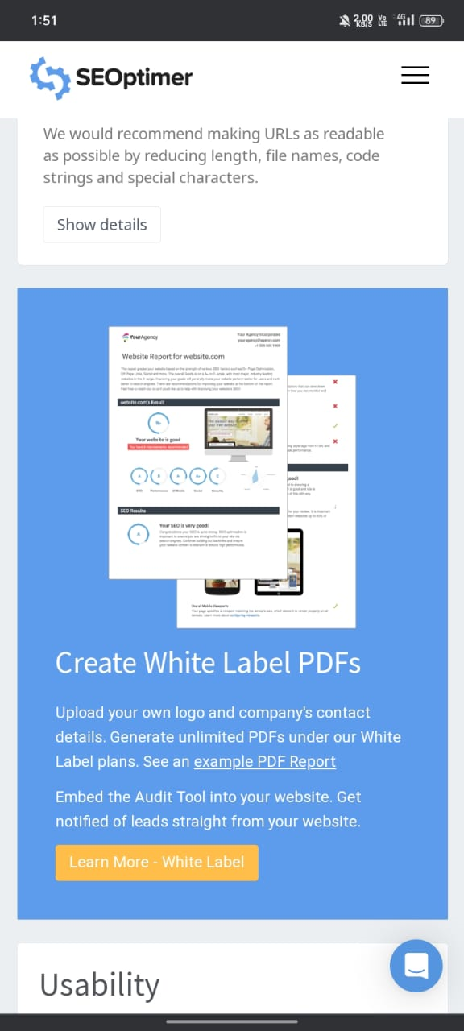
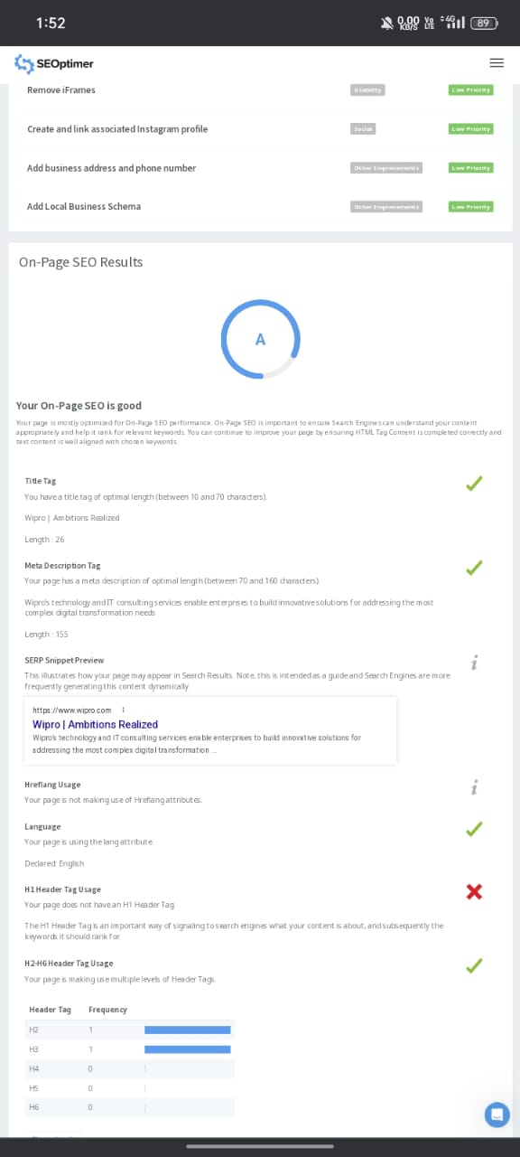
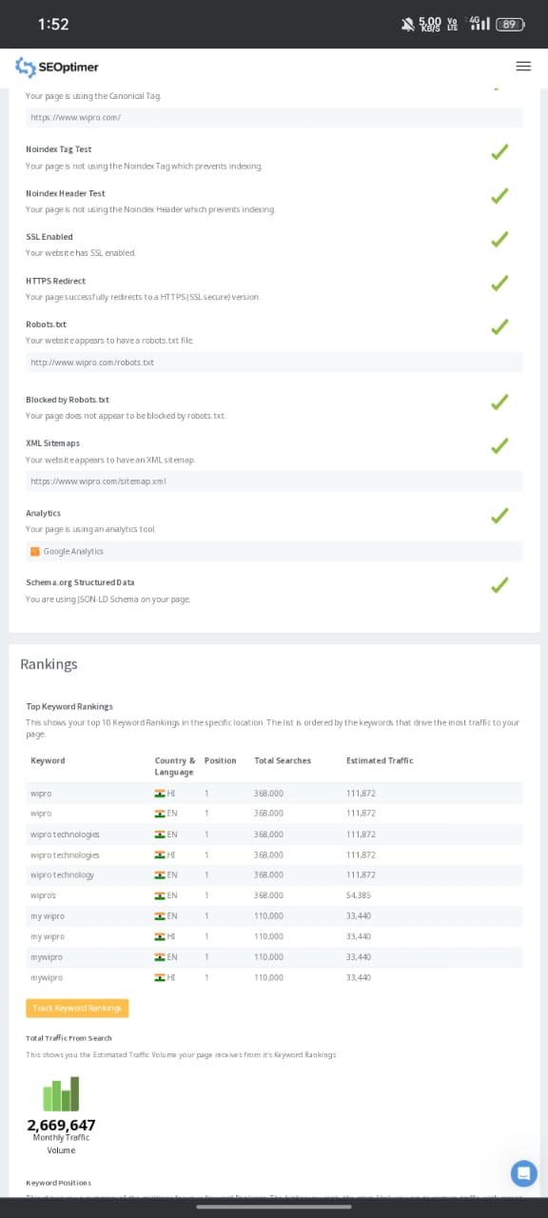
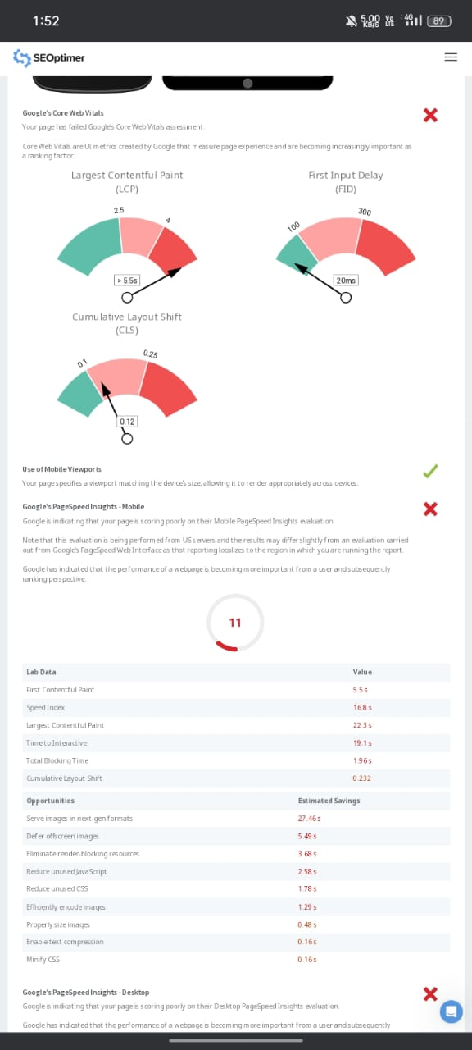
SEO OF WIPRO

Slide 14
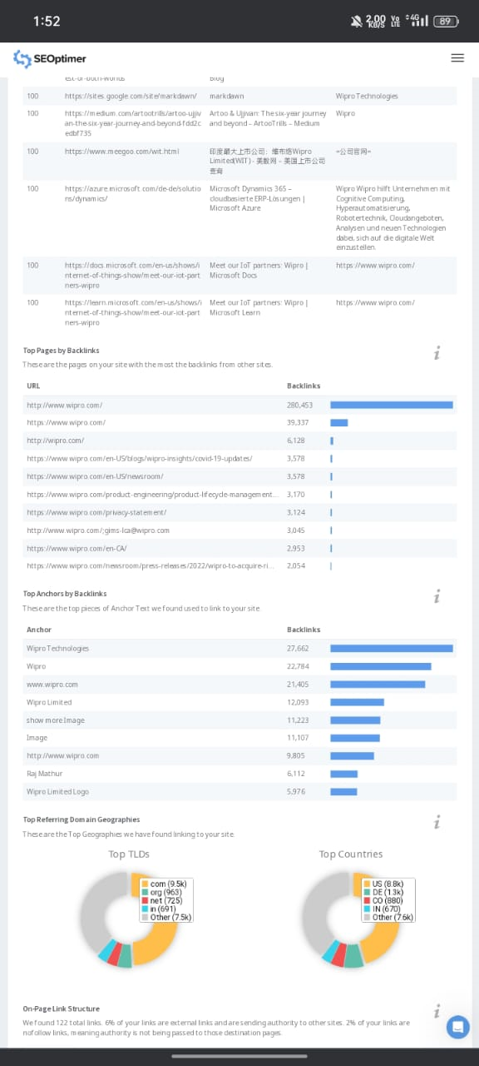
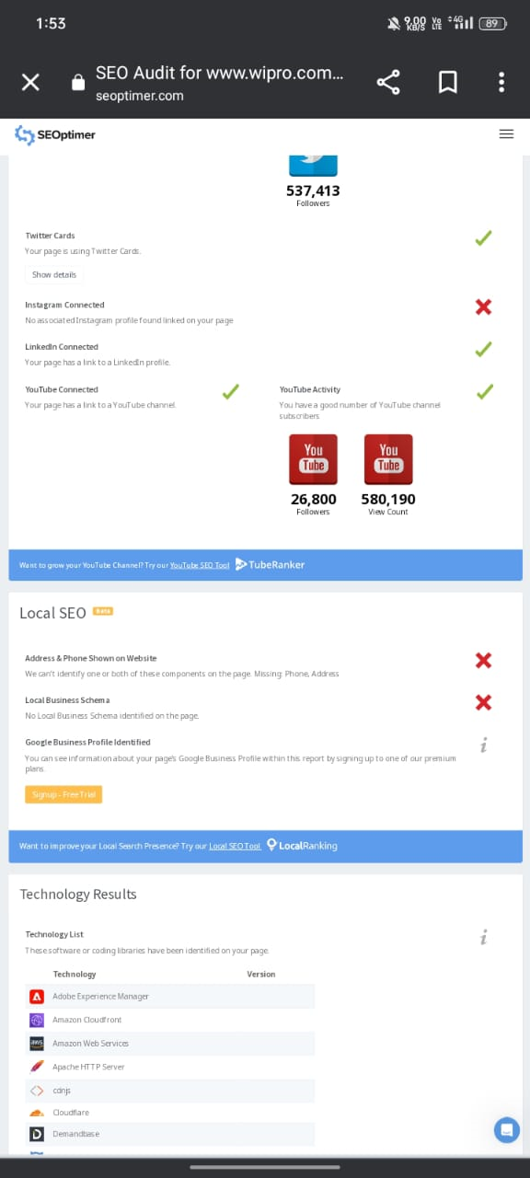
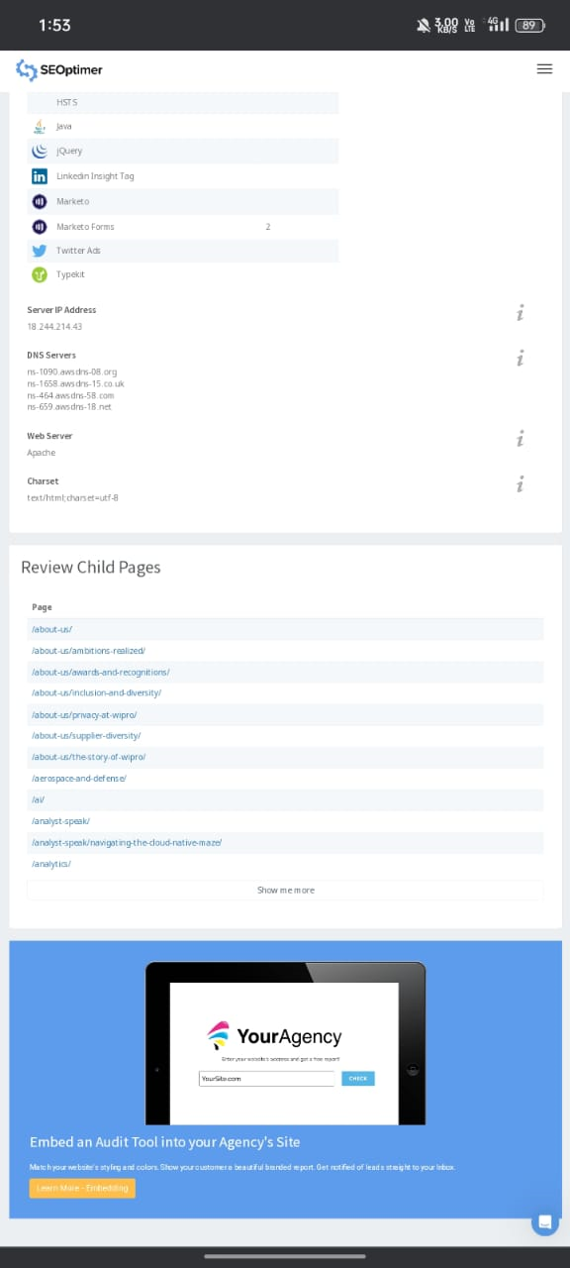

Slide 15
Keyword research
Key word | volume | competition | KEI
WIPRO | 24200 | 64 | 25
WIPRO LIMITED | 3600 | 54 | 28
WIPRO SHARE PIC’S | 2900 | 33 | 73
WIPRO CAREERS | 2200 | 37 | 56
WIPRO TECHNOLOGIES | 1800 | 57 | 23
WIPRO STOCK | 1600 | 35 | 60
WIPRO SHARE PIC’S NSE | 1200 | 25 | 113
WIPRO LOG | 1000 | 30 | 77
WIPRO DIGITAL | 630 | 46 | 30

Slide 16
Content calender
Sunday | Monday | Tuesday | wednesday | thrusday | friday | Saturday
 |  |  |  | 12 | 13 | 14
 |  |  |  | Instagram post chats | webinor | Face book past reel
15 | 16 | 17 | 18 | 19 | 20 | 21
 | ca,mpaingn | Group engagement | New blog | Twitter chat | Connecting customers | Producting customer
22 | 23 | 24 | 25 | 26 | 27 | 28
 | holiday | HOLIDAY | HAOLIDAY | Update blogs | E-book | Curated content
29 | 30 | 31
 | Employee connection | customer connection

Slide 17
Team members contribution
PUKALA LAKSHIMINARAYANA ROLES ; Brand study , Poster creation , SEO audit .
PAGOTI SOWJANYA ROLES ; Ccompetitior analysis , keyword research , instagram story .
MASABATTULA DILISHWARI ROLES ; Brand content , Brand creation .
ALLU RAMYA ROLES; content calender , Brand content
P.JYOTIKAMEHERAKALAYANI ROLES ; Marketing strategies buyers/ Audience person

Slide 18
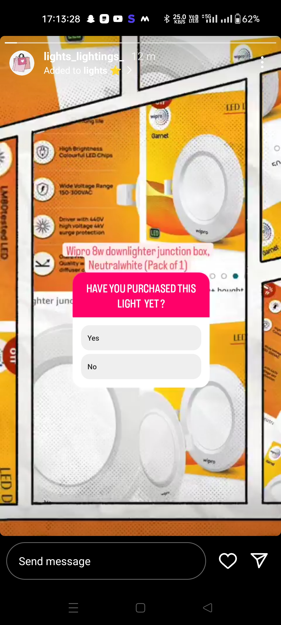
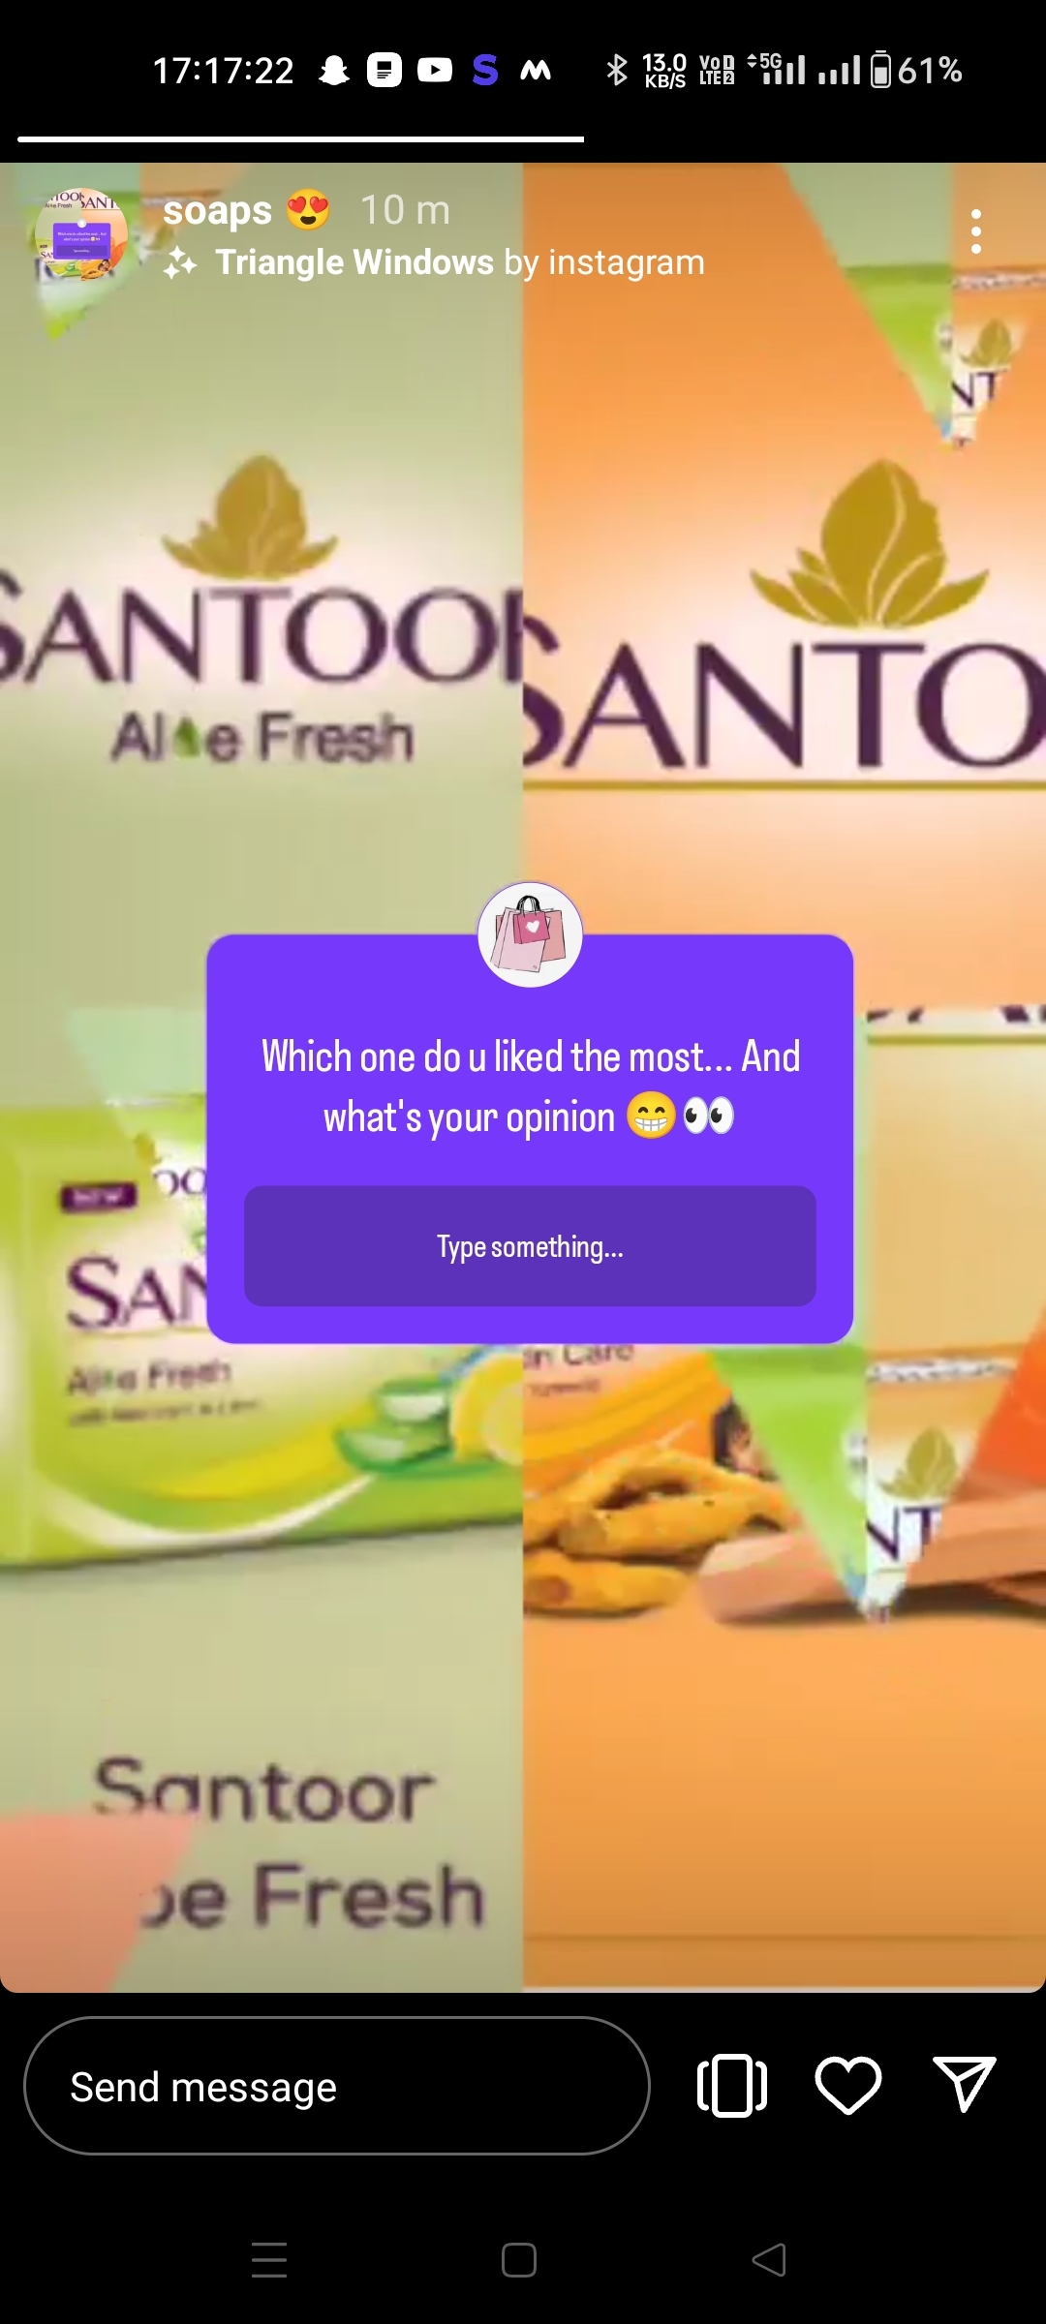
Instagram
Profile url
https://instagram.com/lights_lightings_?igshid=MzRlODBiNWFlZA==
Screenshots.

Slide 19
Thank you

